Slide 1
Performance Calculation and Weight Estimation
Ritwik Shankar

Slide 2
Power System Sizing
Hydrogen fuel considered with Specific Energy Density 0.8-1 KW Hr/Kg
Full system mass to consider Power density of 0.1-0.15 KW /Kg
Initially system weight will be calculated for an estimate T9 = 30 mins, then after getting an estimate system weight from IIT Gn we will maximise T9
Maximum power conditions supplied by the battery

Slide 3
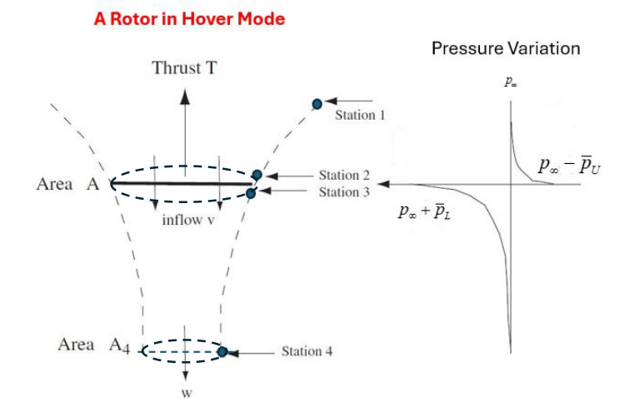
Performance of Hover flight

Slide 4
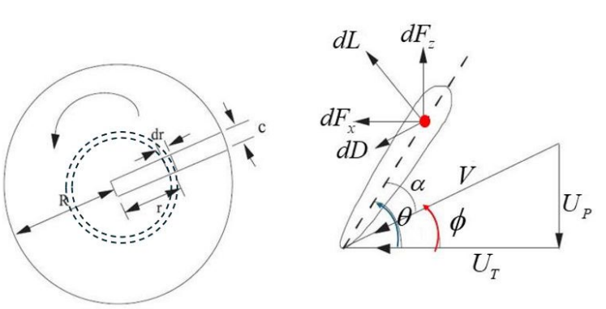
Performance of Hover flight

Slide 5
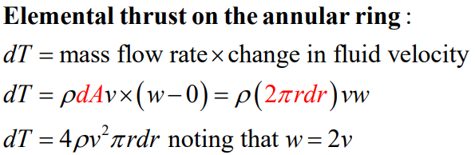
Performance of Hover flight

Slide 6
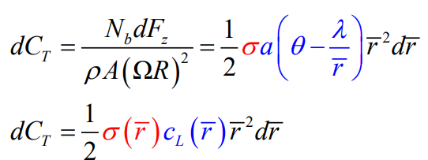
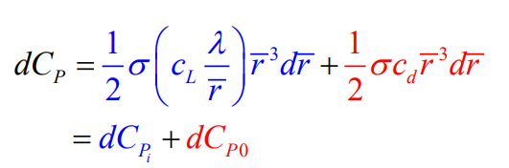
Modelled with Prandtl Tip Loss function
Performance of Hover flight

Slide 7
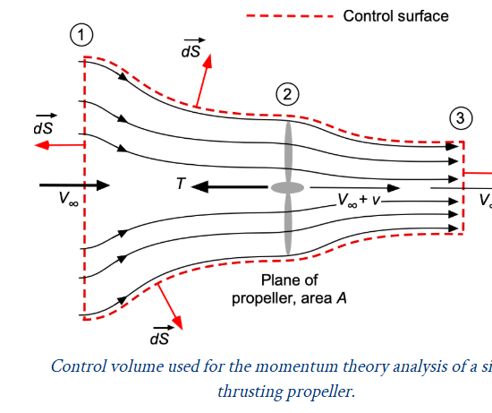
Performance of Cruise flight

Slide 8



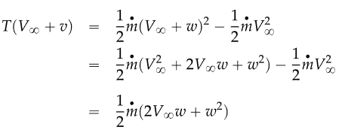
Momentum Theory
Performance of cruise flight

Slide 9




Induced Velocity
Performance of cruise flight

Slide 10

Power
Performance of cruise flight

Slide 11
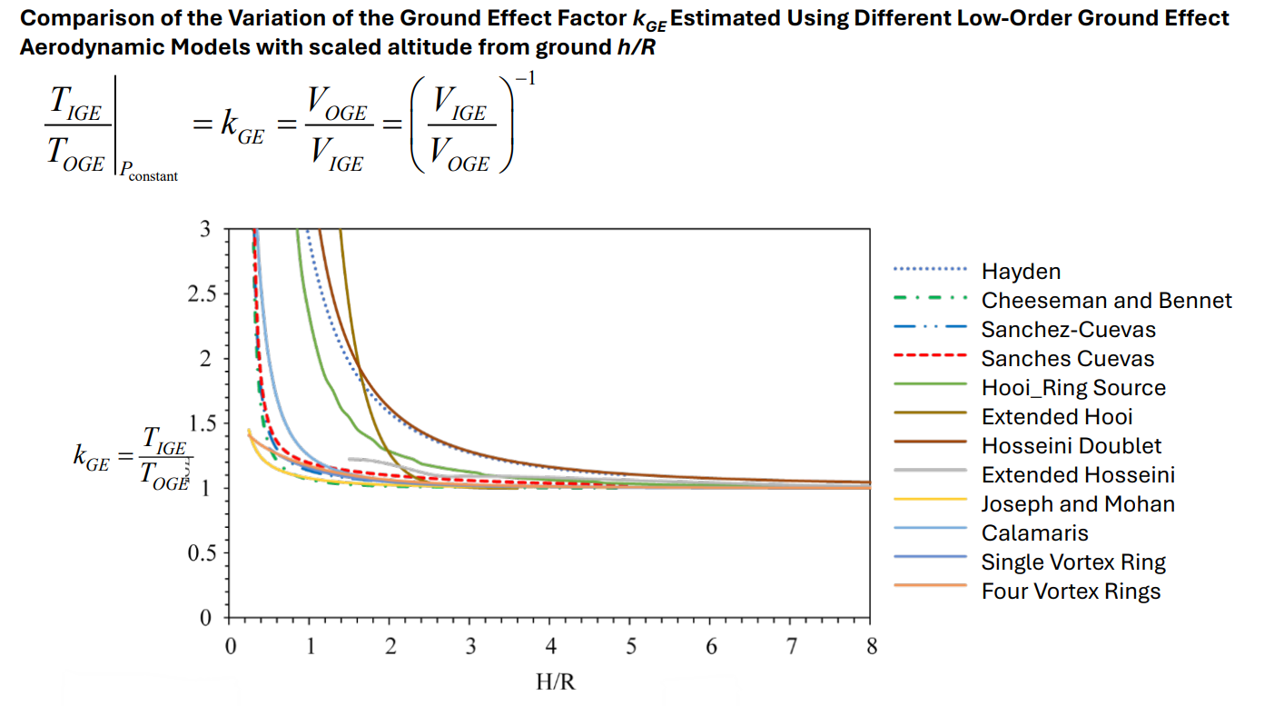
HIGE Low fidelity modelling
Performance of cruise flight

Slide 12

Validation of BEMT performance
We use Harrington rotor experimental results to validate our BEMT performance (in hover mode)
Although that data is for co-axial rotors, we will only take single rotor results
Harrington has results for σ= 0.076 and Tip speed ≈ 392 ft/s so we run our code these values to plot the variation of $C_{Q}$ vs $C_{T}$

Slide 13
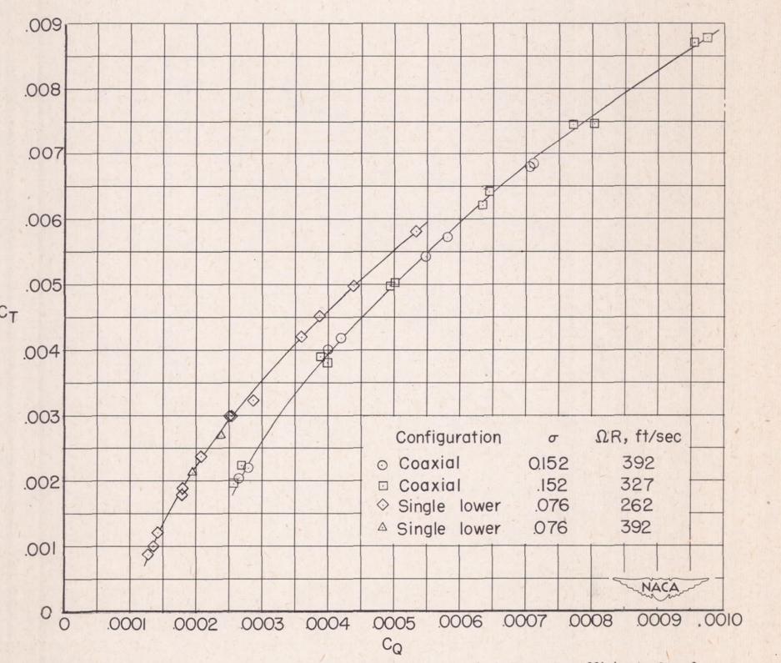
Experimental Data
Chord with no Taper
0.2 blade cutoff

Slide 14
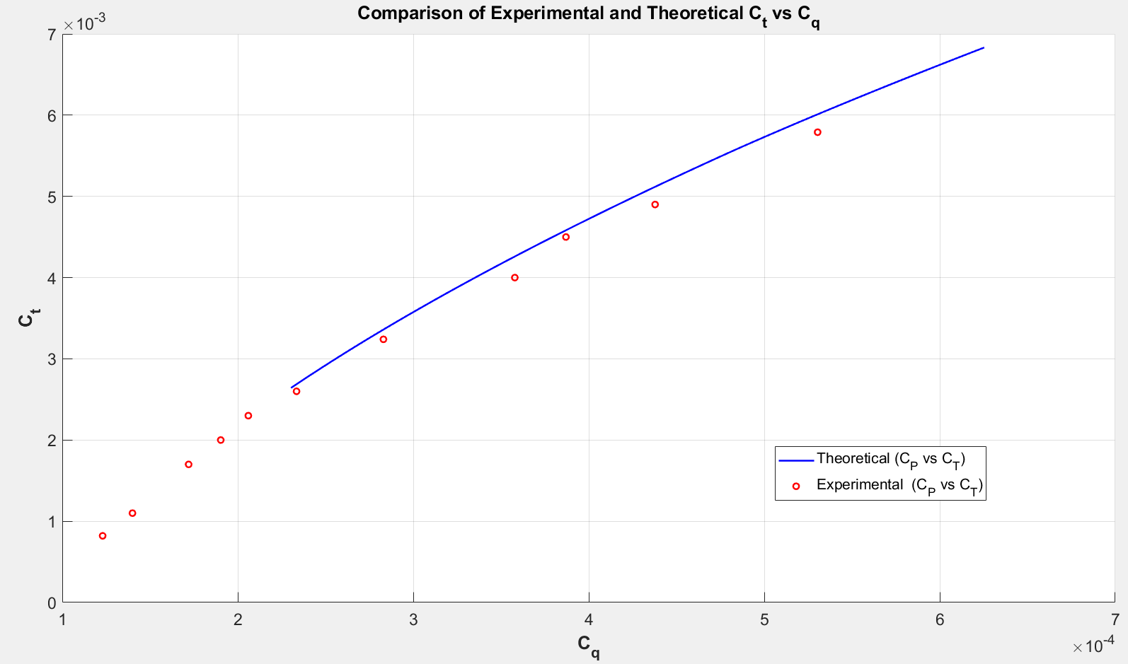
Parameter | Theoretical Value | Experimental Value
Solidity | 0.076 | 0.076
Tip Speed (ft/sec) | 392 | 391.9
Airfoil | NACA symmetric | NACA 0012
Radius (inch) | 150 | 150
Chord (inch) | 18 | 19.1

Slide 16
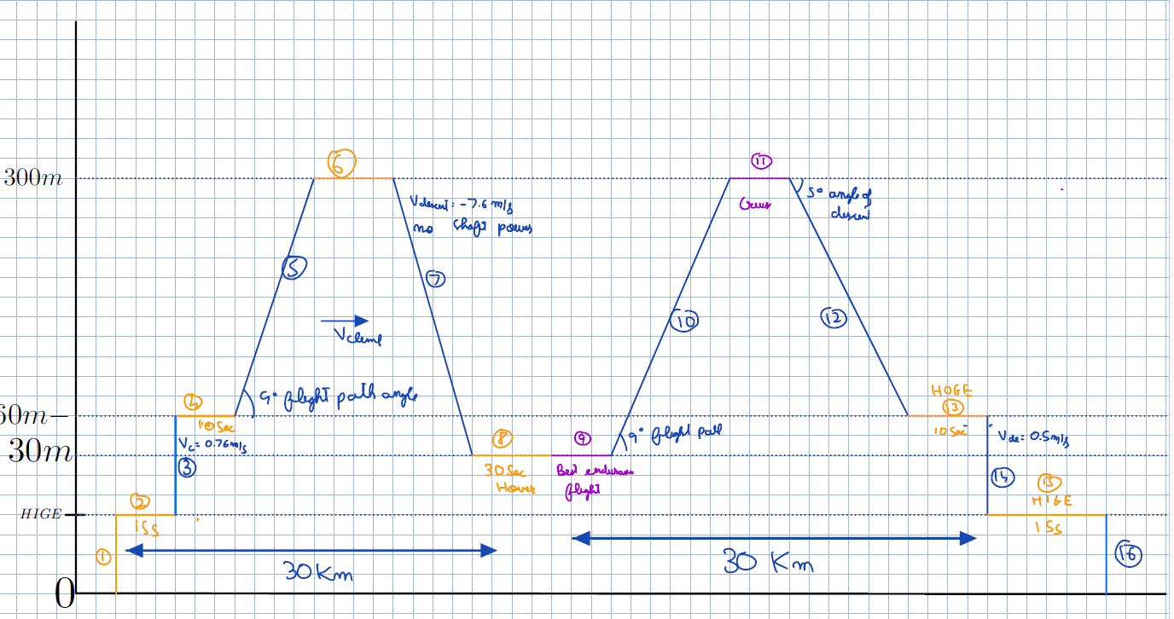
Mission Segment for energy calculations

Slide 17
PARAM | VALUE | PARAM | VALUE
Number of Blades | 3 | Total Hover Power Watt | ~130 KW
NumberOfRotors | 8 | GrossWeight | ~ 627 Kg
Radius | 1 m | Total Energy | ~130 kW Hr
RPM | 3000 | Twist | -18 degrees
Descent Speed | -0.5m/s | CollectiveInDegrees | ~21.59
Hover Climb Speed | 0.76 m/s | PowerLoading | 0.049
CruiseVelocity | 50 m/s | DiskLoading | 245 N/m^2
T9 time to be maximised for loiter | 60 mins | AspectRatio | ~12
Climb Velocity(section 5) | 6 m/s | Cl design | 0.9
Rotors active in cruise | 2 | V_endurance (cl) | 45 m/s( 1.11)
BEMT PARAMS

Slide 18

Section 2 HIGE for 15 seconds
Parameter | Value
Hover Power (HOGE) | 130 kW
Hover Power (HIGE) using HIGE models | ~86 kW
Energy Consumed | ~1.29 MJ
Power System | Hydrogen system

Slide 19
Section 3 Vertical climb @0.76m/s to 60m
Parameter | Value
Hover power | 130 kW
Climb Power | 135 kW
Climb Velocity | 0.76 m/s
Energy Consumed | 12.6 MJ
Power system | Battery System

Slide 20
Section 4 HOGE for 15 seconds
Parameter | Value
Hover Power (HOGE) | 130 kW
Energy Consumed | 1.30 MJ
Power System | Battery

Slide 21

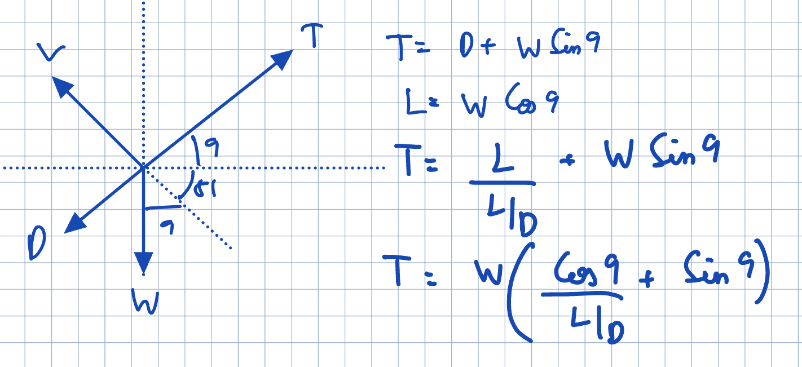
Section 5 Climb from 60m to 300m @ 9 degrees flight path angle
Parameter | Value
Cruise Power | 80 kW
Climb Velocity (ROC) | 6 m/s
Excess power | 36Kw
Energy Consumed | 4.68 MJ
Power system | Hydrogen

Slide 22
Section 6 Cruise Flight at V_cruise for 30Km
Parameter | Value
Thrust required | ~769 N
Cruise Power (MT theory) | 80 Kw
Cruise Velocity | 50 m/s
Energy Consumed | 48.17 MJ
Power system | Hydrogen

Slide 23
Section 7 Powerless Dive
Parameter | Value
Thrust required | 0
Cruise Power (MT theory) | 0
Cruise Velocity | To be determined
Energy Consumed | 0
Power system | -

Slide 24
Section 8 HOGE for 30 seconds at 30m
Parameter | Value
Hover Power (HOGE) | 130KW
Energy Consumed | 3.9 MJ
Power System | Battery

Slide 25
Section 9 Endurance flight for T9 seconds
Parameter | Value
Thrust required | ~737 N
Cruise Power (MT theory) | 72 KW
Cruise Velocity endurance Dependent on Cl_max | 45 m/s for now (1.11 Cl_max)
Energy Consumed | 261 MJ
Power system | Hydrogen

Slide 26
Section 10, 11 and 12 are similar to section 5, 6 and 7.

Slide 27
Estimate Wing sizing (Done after getting data from aerodynamic people)
Parameter | Value
span | 5 m
chord | 0.53 m
Cl design targetted | 0.8
AR | 12
taper | 0.4

Slide 28
PARAM | VALUE (kg) | PARAM | VALUE
Hydrogen weight | ~150.45 | Electrical weight | ~4.37
Battery Weight | 28.6 (<30) | 1 Wing | ~ 12
Fuel system | ~ 50 | Landing gear | ~6.27
Fuselage | 141.11 | Fixed weight | ~ 13.56
1 Motor | ~1.7 | rotor group | ~ 30
1 Rotor | ~1 .36 | Power system weight | ~ 224
Esc mass | 0.5 | Empty | ~ 218
Avionics | ~10.91 | Payload | ~ 185
Instruments | 2.4 | Gross Weight | ~ 628
Weight Estimation

